Slide 1
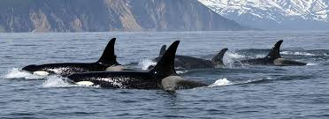
Salinity Regulation In Marine Mammals
Salinity Regulation In Marine Mammals
Presented by Group 30
1

Slide 2
OUTLINE
Introduction.
Impacts of salinity on mammals
Physiological Adaptations of mammals
Behavioral Adaptations of mammals
Structural Adaptations of mammals
Examples of Plants adapted to High salinity
Conclusion
2

Slide 3
INTRODUCTION
Salinity Regulation in Marine Mammals refers to the process by which these animals maintain an appropriate balance of salt and water in their bodies when living in varying marine environments.
Marine mammals face challenges in coping with the fluctuating salinity levels of oceans, seas, and other aquatic habitats. This process is crucial for their survival and overall well-being.
3

Slide 4
CLASSIFICATION OF MARINE MAMMALS
Marine mammals are classified into four different taxonomic groups:
cetaceans (whales, dolphins, and porpoises)
pinnipeds (seals, sea lions, and walruses)
sirenians (manatees and dugongs)
and marine fissipeds (polar bears and sea otters).

Slide 5
IMPACTS OF HIGH SALINITY ON MAMMALS
High salinity levels cause rapid water loss in mammals, causing dehydration through osmosis.
High salinity may cause mammals to change behaviors, seek freshwater sources, or reduce activity.
Excessive salt intake disrupts electrolyte balance, affecting nerve and muscle function, affecting sodium and potassium levels.
4

Slide 6
IMPACTS OF HIGH SALINITY ON MAMMALS
CONT’D
Mammals' kidneys regulate water and salt balance; high salinity strains them, impairing excretion and causing kidney dysfunction.
High salinity environments cause increased competition and aggression, leading to foraging.
5

Slide 7
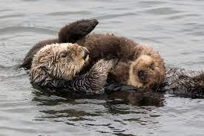
PHYSIOLOGICAL ADAPTATIONS
Efficient kidney function
Salt glands
Limited Sweat Glands
Concentrated Saliva:
Fig.1 Sea Otter
6

Slide 8
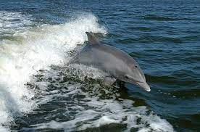
BEHAVIORAL ADAPTATIONS
Seeking freshwater sources
Changing habitat
Obtaining water from prey
Conserving body heat and water during dives
Fig.2
7

Slide 9
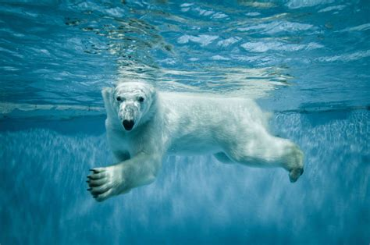
STRUCTURAL ADAPTATIONS
They posses specialized kidneys to produce concentrated urine to conserve water
Low permeability of the skin to conserve water loss
Fig. 3
8

Slide 10
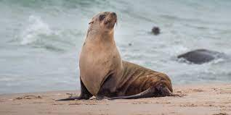
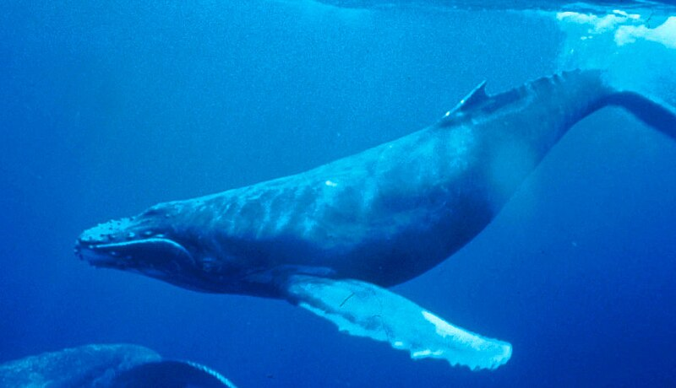
EXAMPLES OF MAMMALS ADAPTED TO HIGH SALINITY IN MARINE
Fig.6 pinnipeds
Fig.7 Humpback Whale
9

Slide 11
CONCLUSION
Marine mammals' species-specific adaptations vary across various environments, affecting their wellbeing, reproduction, and ecological function. Understanding and protecting these adaptations is crucial for their survival, as human activities and climate change impact marine habitats. Appreciating and conserving these adaptations can contribute to sustainable cohabitation and conservation of marine animals' habitats.
10

Slide 12
References
Adams, S.H. and Costa, D.P. (1993). Water conservation and protein metabolism in northern elephant seal pups during the postweaning fast. Journal of Comparative Physiology B 163: 367– 373..
Dierauf, L. A., & Gulland, F. M. (Eds.). (2001). CRC Handbook of Marine Mammal Medicine (2nd ed.). CRC Press.
Kooyman, G. L., & Ponganis, P. J. (Eds.). (1998). The Physiological Ecology of Seals. Cambridge University Press.
Castellini, M. A., & Mellish, J. E. (2002). Marine mammal adaptations to polar and tropical environments. Polar Research, 21(1), 19-26.
Gartner, H. V., & Bedford, J. J. (2001). Water balance and renal function in marine and estuarine mammals. Journal of Comparative Physiology B, 171(5), 437-442.
Ortiz, R. M. (2001). Osmoregulation in marine mammals. The Journal of Experimental Biology, 204(11), 1831-1844.
Trillmich, F., & Wolf, J. B. (2008). Parent-offspring and sibling conflict in Galápagos fur seals and sea lions. Behavioral Ecology and Sociobiology, 62(3), 363-375.
Costa, D. P., & Gentry, R. L. (1986). Effects of salinity on water flux, energy metabolism, and food consumption of sea otters. Journal of Comparative Physiology B, 156(1), 31-39.
11

Slide 13
GROUP MEMBERS
ADDO LAWENCIA 9194519
ASARE DERRICK BAFFOUR 9202319
AMOAH PRECIOUS NAA ODEY 9198719
ACKUAKU EDINAM JESSICA 9194019
AMOFA AUGESTINE KESSIE 9199019
STEPHANIE ANITA HAGAN 9209119
OBIRI STEPHEN KWEKU 9214119
12

Slide 14
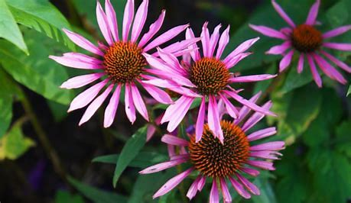
THANK YOU
13

